Slide 1
British Airways
Predictive model and its results
BY: Ogbuzuru Kelechi
2023-12-09

Slide 2
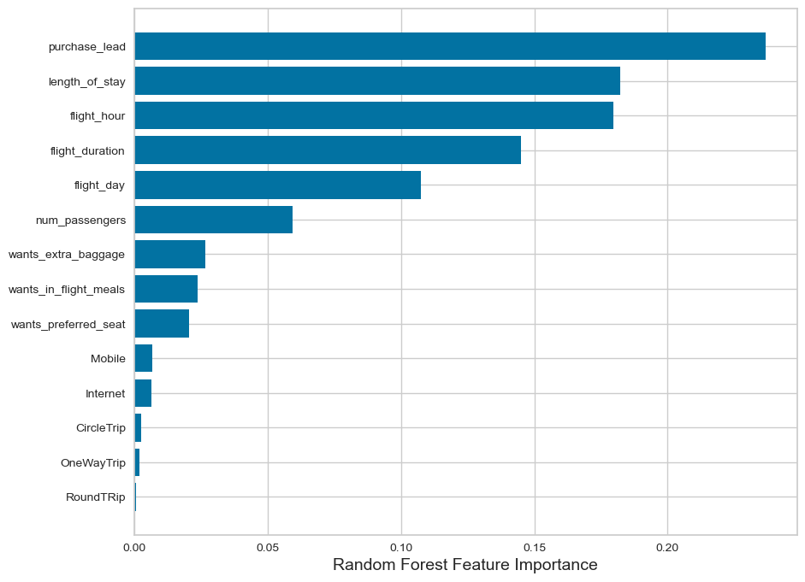
Predictive modelling results
Recall Rate
64%
Precision
62%
Accuracy
62%
Chance of predicting true successful bookings.
Will be predicted as actually completed bookings out of all successfully completed bookings.
Accuracy of the model predicting successful or incomplete booking is
66% Chance of predicting true incomplete bookings correctly.
Our focus lies in improving the accuracy of predicting successful bookings. While balancing the dataset enhances overall accuracy, it does not ensure precise predictions of successful bookings. The dataset was adjusted to include 8,000 instances labeled as incomplete bookings and 7,000 as complete bookings.
Top features that can drive successful flight bookings.

